Slide 1


Visualizing Rossmann Stores Sales
Mahesh Babu Neelam
Master of Science in Information Quality
T00604964

Slide 2
Objective
To visualize the data that helps compare the stores’ sales through out a period and impact of promotions on the sales.

Slide 3

Data
The dataset consists of historical sales data and supplemental information about the stores.
The dataset is in .csv format and collected from the website kaggle.com.
The attributes used for the visualization are Store_ID, Date, Open, Promo, Sales, Latitude, Longitude, holiday,ZipCode, State, Country.

Slide 4
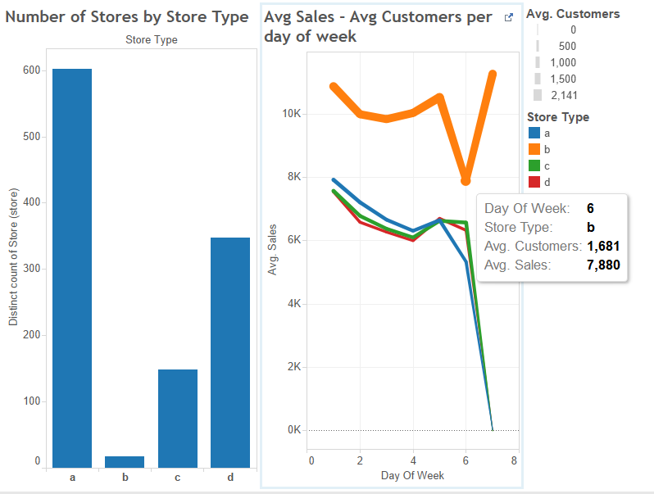
Avg. Sales by Store Type

Slide 5
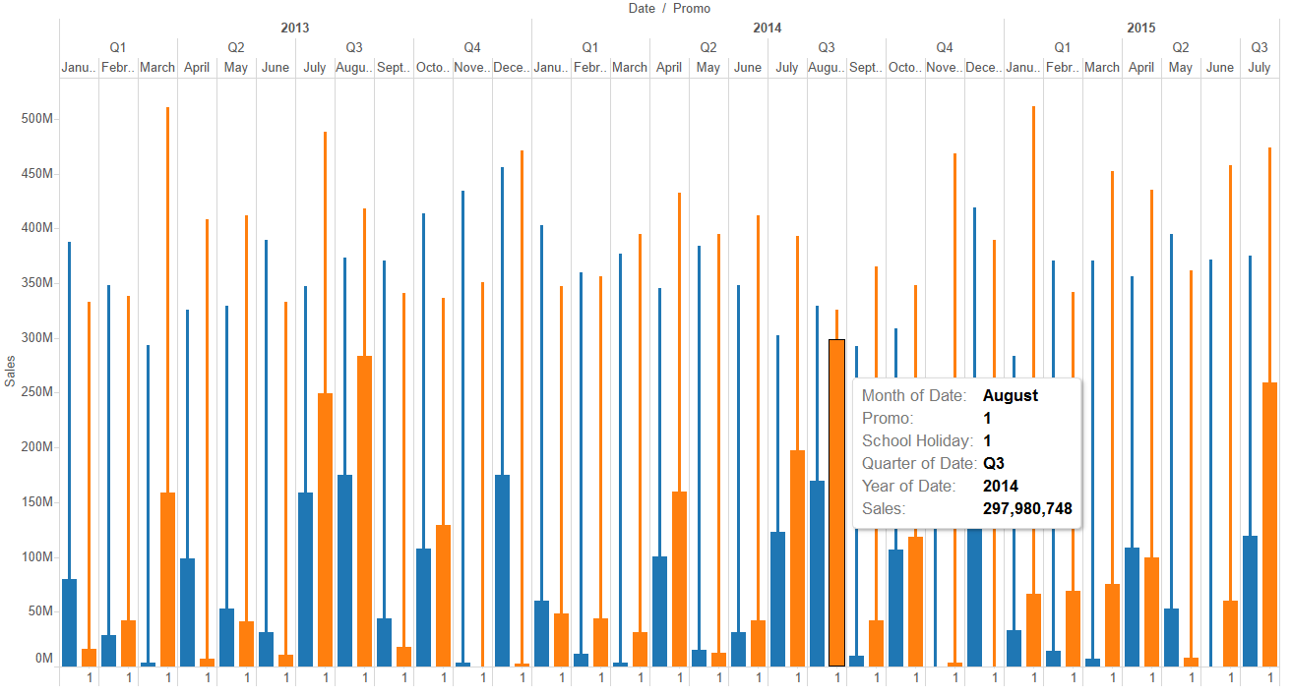
Impact of holidays on Sales

Slide 6
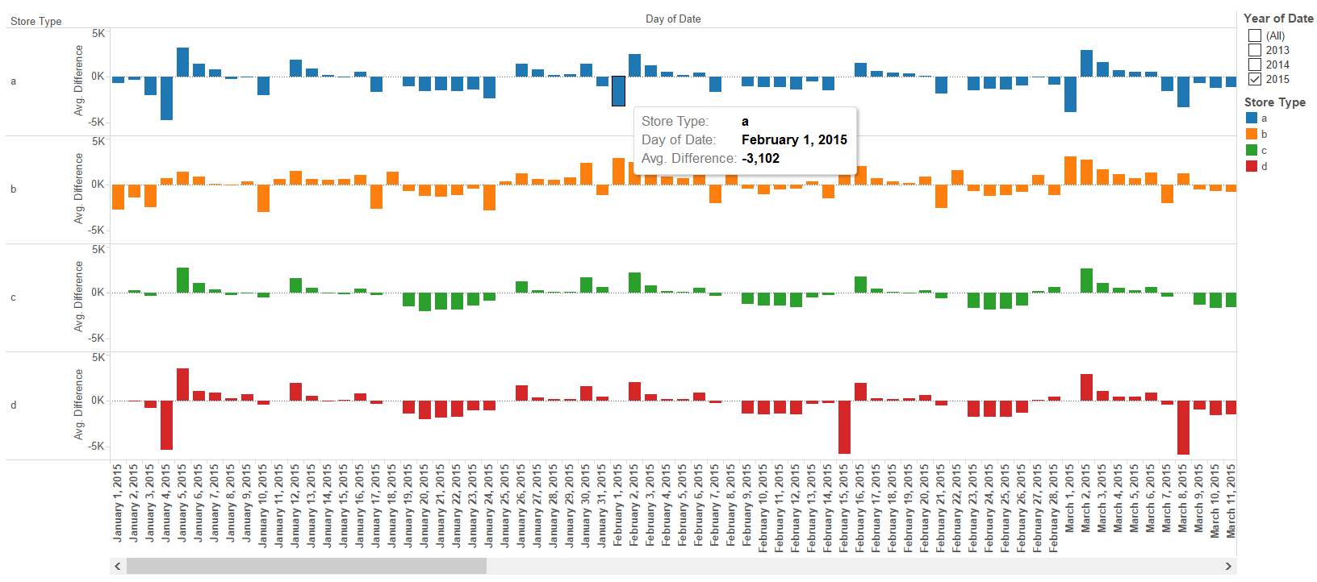
Comparison of Daily Sales with Avg. Sales

Slide 7
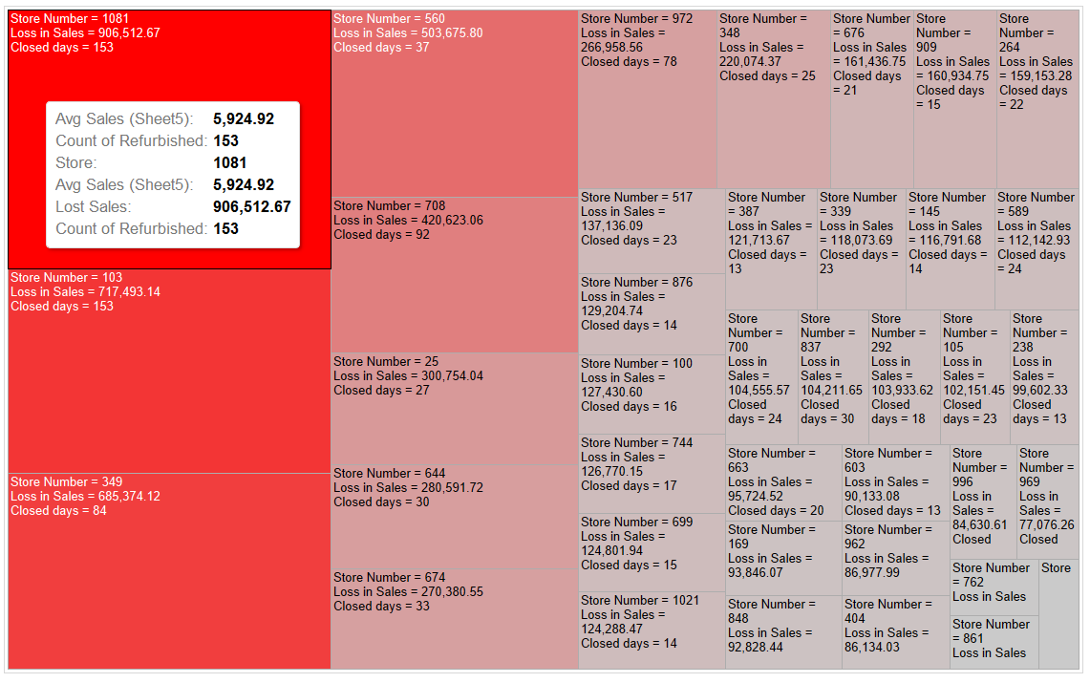
Loss in Sales due to Refurbishment

Slide 8
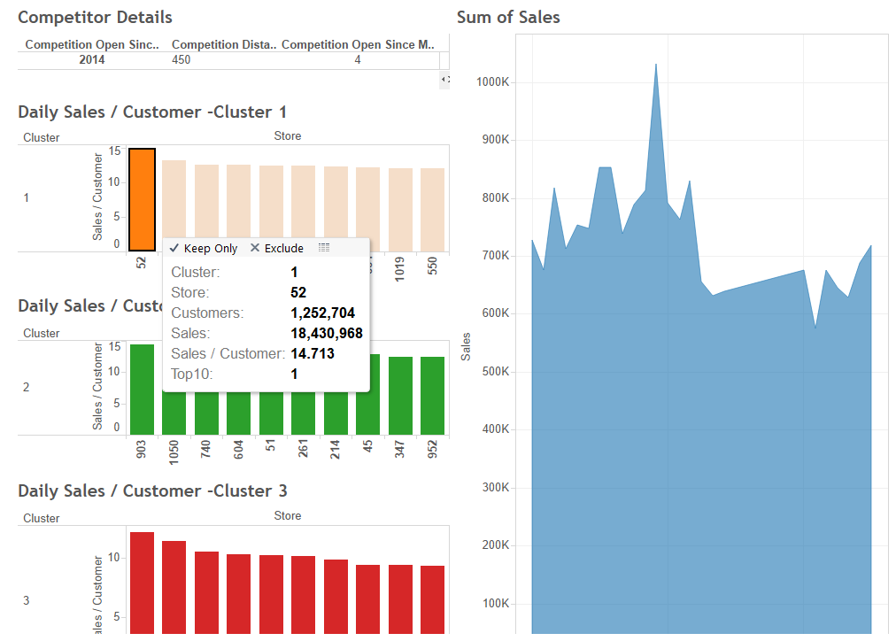
Competitors effect on Sales

Slide 9
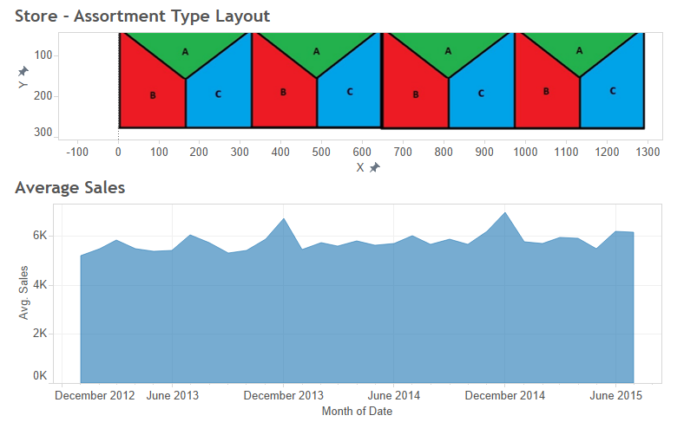
Assortment Analysis

Slide 10
Tools Used
Tableau 9.2
Alternatives
matplotlib
D3.js

Slide 11
Thank You…!!!

